Slide 1
INDIAN
CUTURAL HERITAGE
Diverse cultures, ancient traditions, rich history, and unity

Slide 2
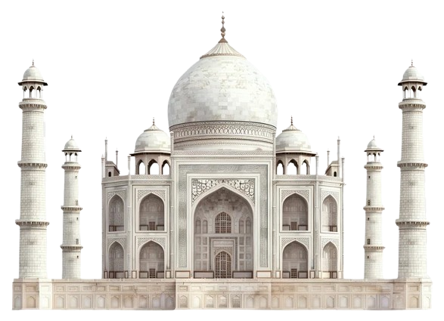
TAJ MAHAL
INDIAN
CUTURAL HERITAGE
Diverse cultures, ancient traditions, rich history, and unity

Slide 3
TAJ MAHAL
Combines Persian, Islamic and Indian architectural styles
Built as a tomb for Mumtaz, Shah Jahan’s wife
It is known for its perfect symmmetry

Slide 4
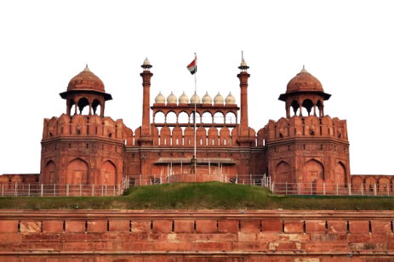
RED FORT
The fort is an irregular octagon combining Persian,Timurid,and Indian architectural styles.
Designed by Ustad Ahmed Lahori

Slide 5
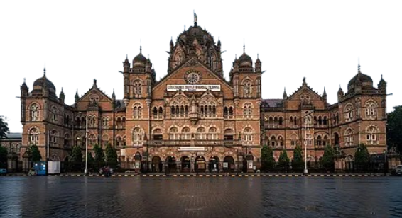
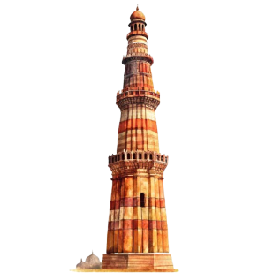
OUR INDIAN HERITAGE

Slide 6
OUR INDIAN HERITAGE

Slide 7
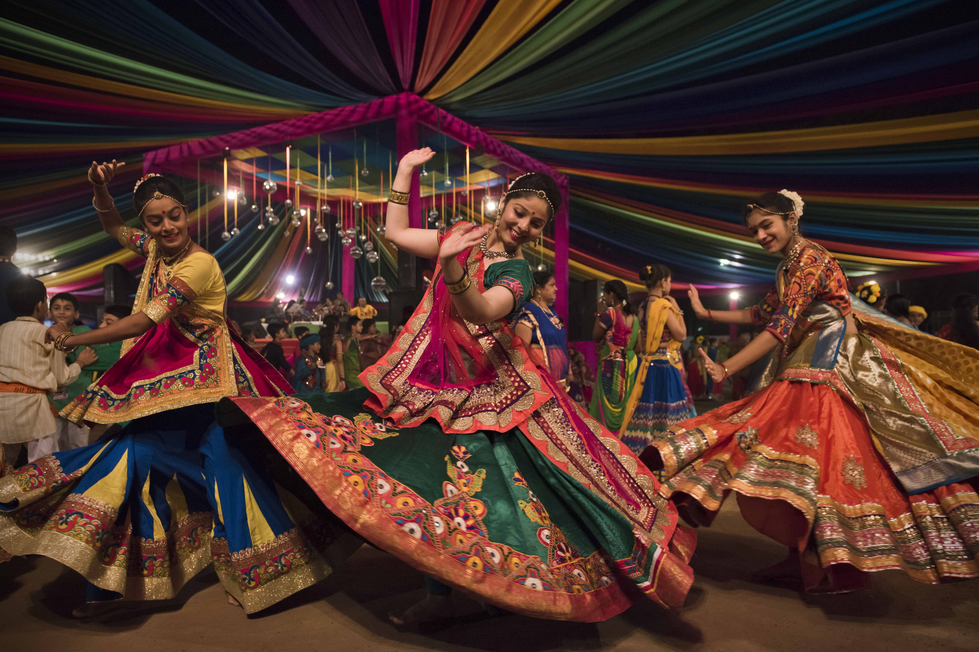
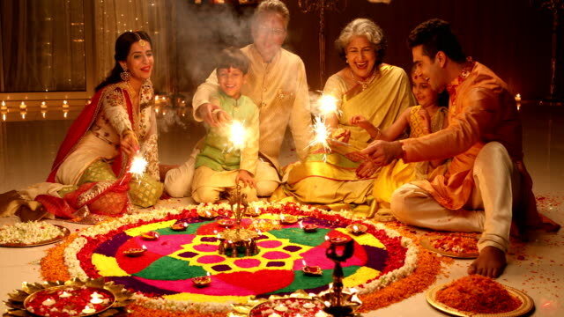
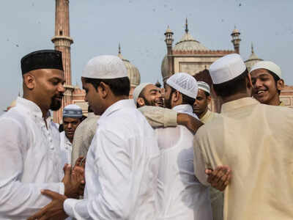
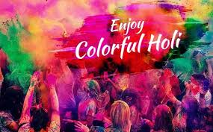
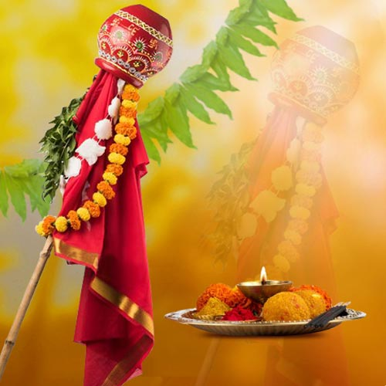
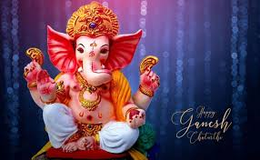
Indian Festivals

Slide 8
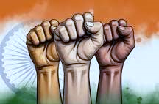
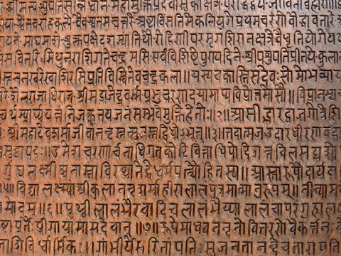
Unity in diversity
Representing various faiths , regional, and artistic traditions , these sites showcase a united , diverse, and pluratistic national identity

Slide 9
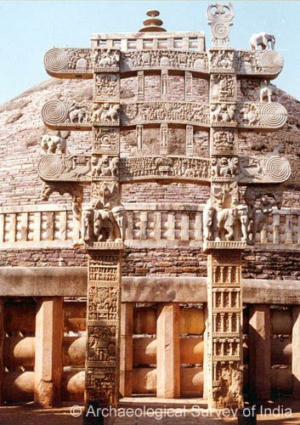
Literature And Ancient Texts
Indian literature spans ancient texts like the Vedas and Mahabharata, showcasing diverse languages and epics. Modern works reflect cultural richness, with contribution in poetry, prose, and philosophical writings.

Slide 10
Indian Heritage embodies a tapestry of ancient wisdom, diverse culture, vibrant traditions, and architectural marvels, fostering a deep appreciation for its rich history and enduring legacy.

